Slide 1
SALES ANALYSIS
LY NGUYEN THIEN BAO

Slide 2
TABLE OF CONTENTS
1.
2.
3.
4.
5.
DATA INFORMATION,
ANALYSIS TOOL
VISUALIZATION
PROBLEMS
IDENTIFICATION
RECOMMENDATIONS
EXECUTIVE
SUMMARY

Slide 3
01.
DATSET INFORMATION AND ANALYSIS TOOL

Slide 4
GLOBAL SUPERSTORE DATASET
“Global Superstore is a virtual business operating in the Ecommerce sector, specializing in providing technology products, furniture, and office supplies to individuals and businesses worldwide.“
However, in recent years, the company's CEO has assessed that the company's operations have not been efficient and show signs of stagnation. They are puzzled as to why the growth rate is low, profit margins are not high, and the rate of new customers is decreasing. Therefore, they have provided a dataset including the following information:
Orders information: Order ID, order date, delivery date, quantity, profit...
Customer information: Name, address, country, region,...
Product information: Product name, price, product type,...
Dataset: Global Super Store Dataset
Data format: .csv
Source: https://www.kaggle.com/datasets/apoorvaappz/global-super-store-dataset

Slide 5




ANALYSIS TOOL
EXCEL
POWER BI
POWER BI
PYTHON
Cleaning, Preprocessing
Storage, Transformation, Aggregation, Querying
Visualization, Modeling,
DAX function, Interactive reports
Data mining,
ML model

Slide 6
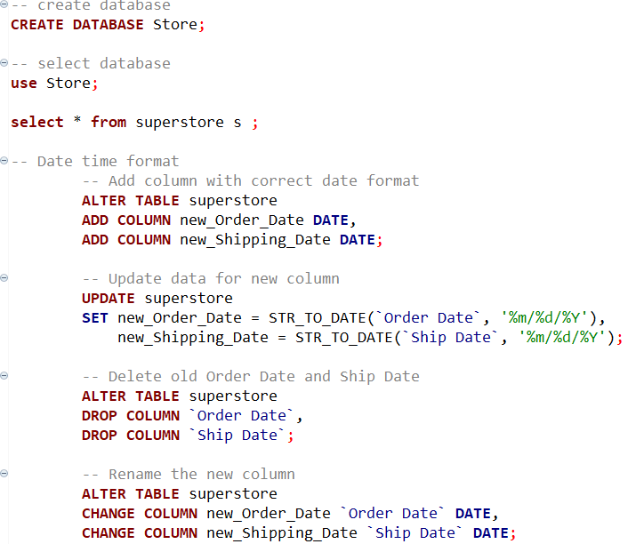
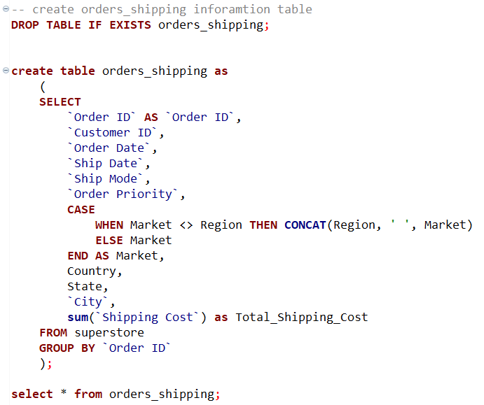
STORAGE, FORMATTING, CREATING RELEVANT TABLE
Storage and formatting
Create relevant table
Use MySql to create database, format datetime
Create table with Aggregate Function, Case When,… functions

Slide 7
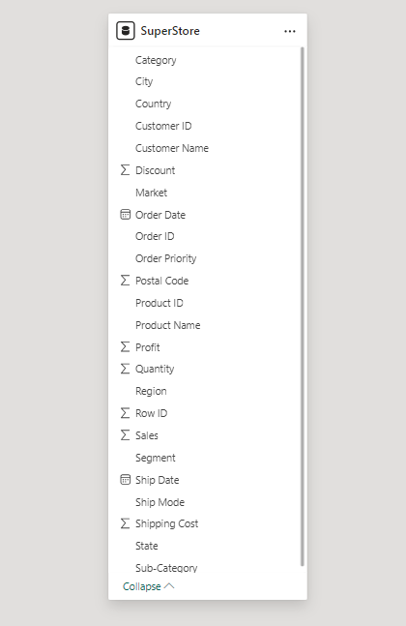
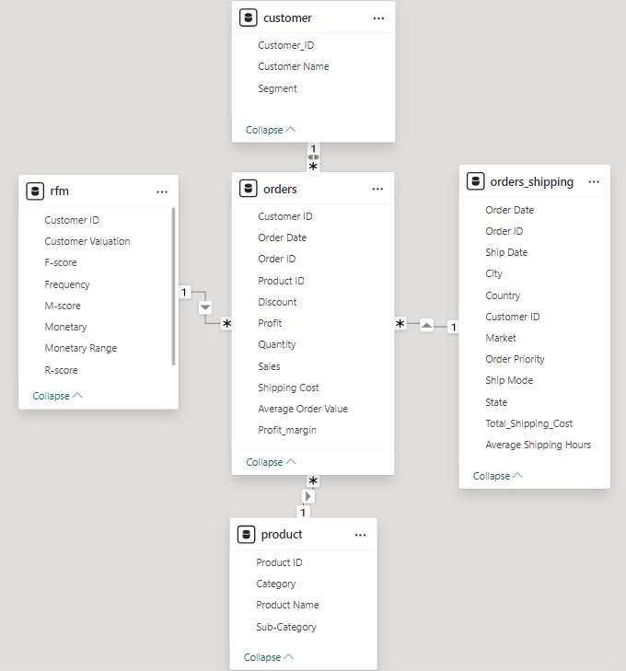
DATA MODELLING

Slide 8
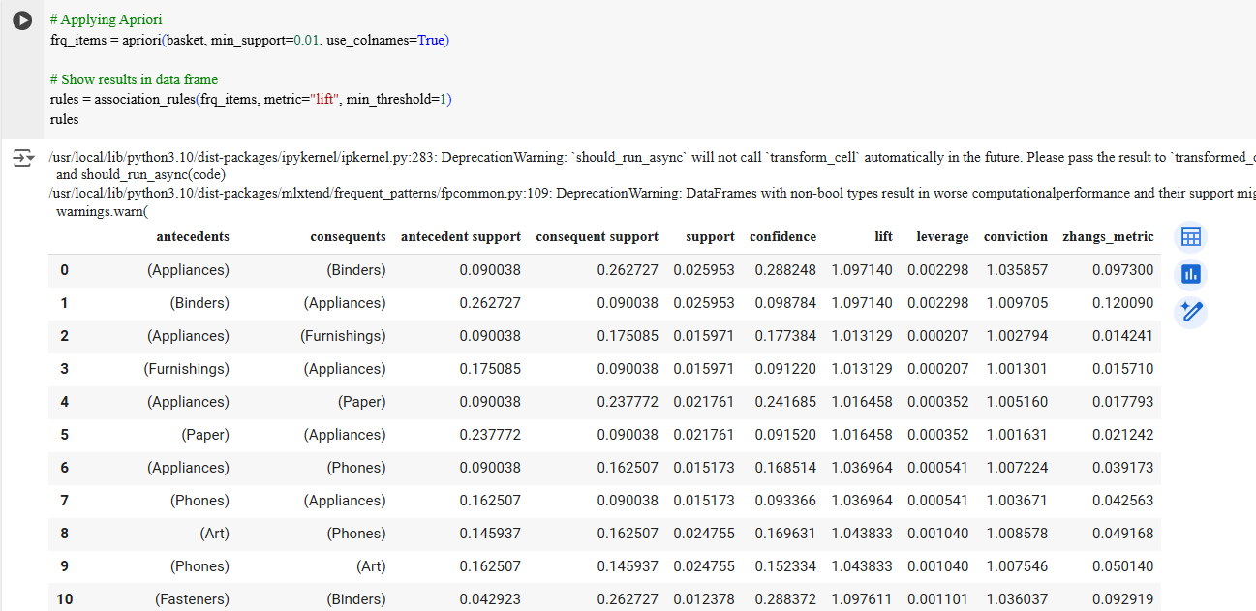
APRIORI DATA MINING

Slide 9
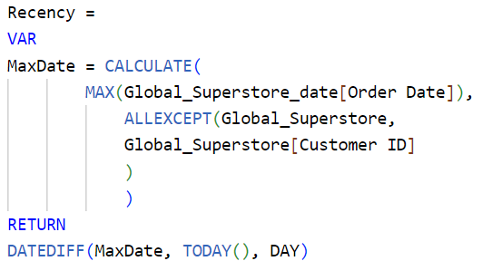
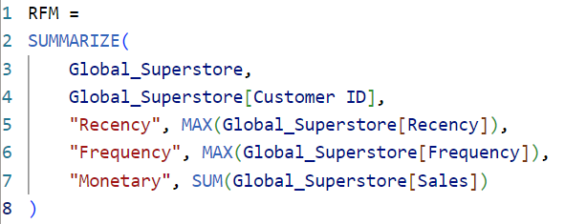
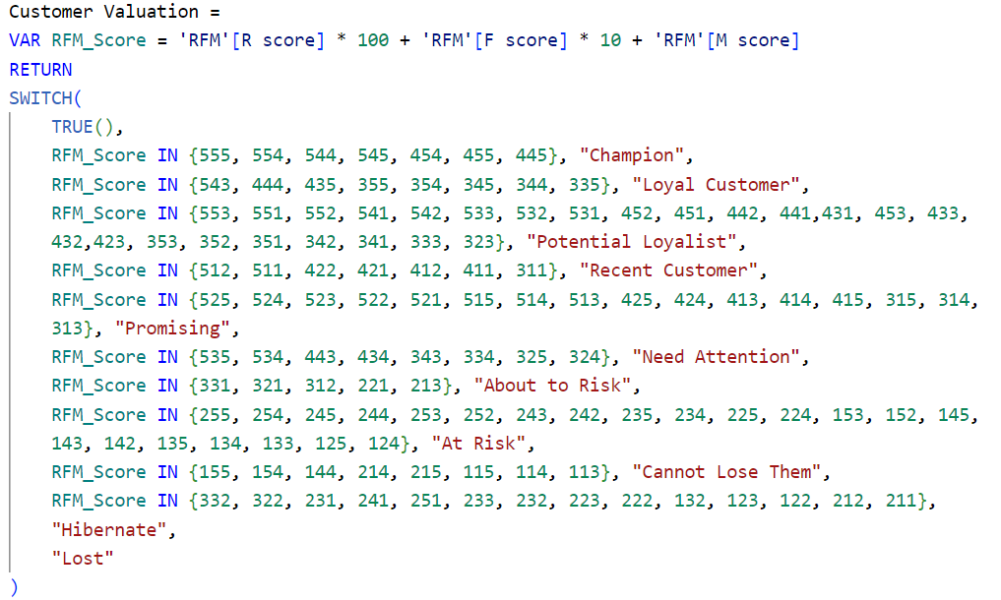
DAX FUNCTION
CREATE MEASURE
CREATE TABLE RFM
CREATE COLUMN
Calculate "Recency" by finding the last transaction date, using ALLEXCEPT to retain Customer ID, and DATEDIFF for the date calculation
Create RFM table by calculating Recency, Frequency, and the sum of Sales grouped by Customer.
Calculate the RFM Score using variables and identify customer segments based on provided conditions using the SWITCH function.

Slide 10
02
DATA VISUALIZATION

Slide 11
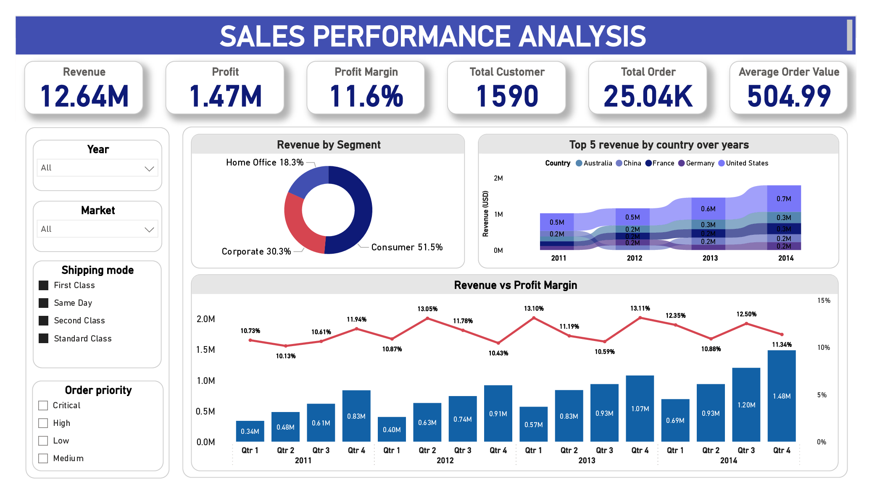
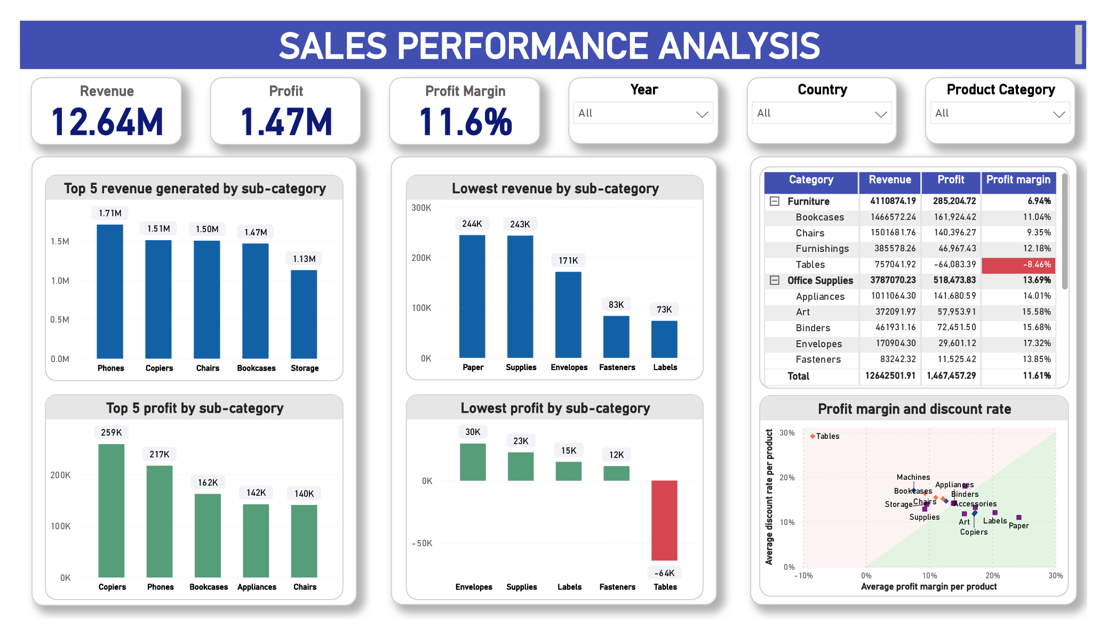
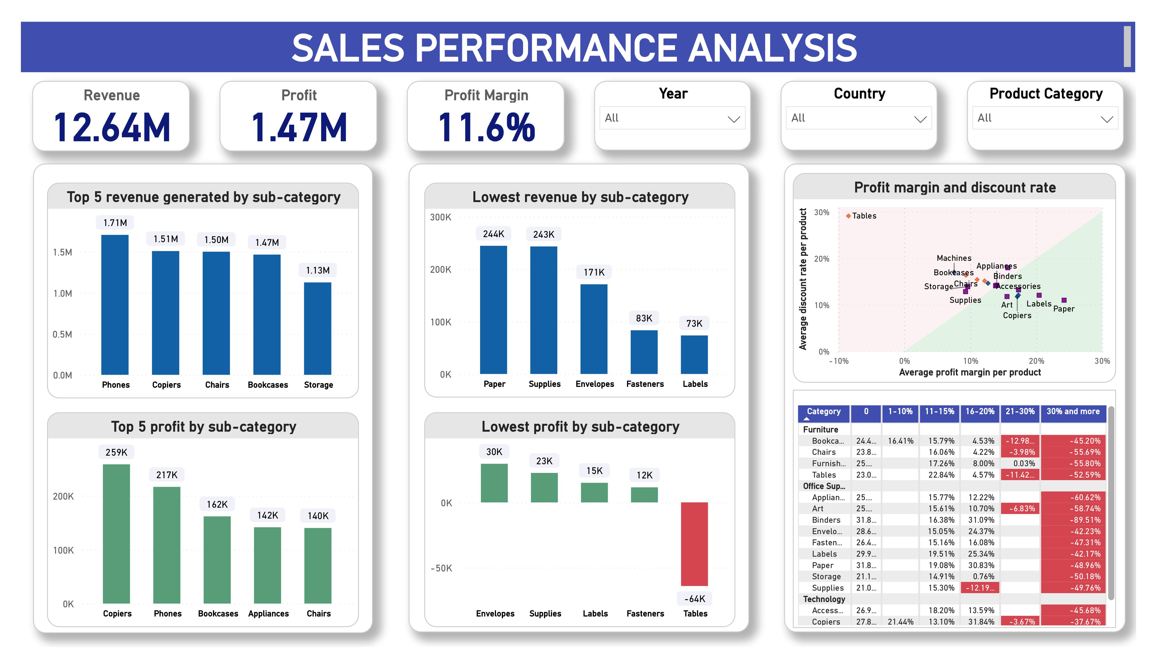
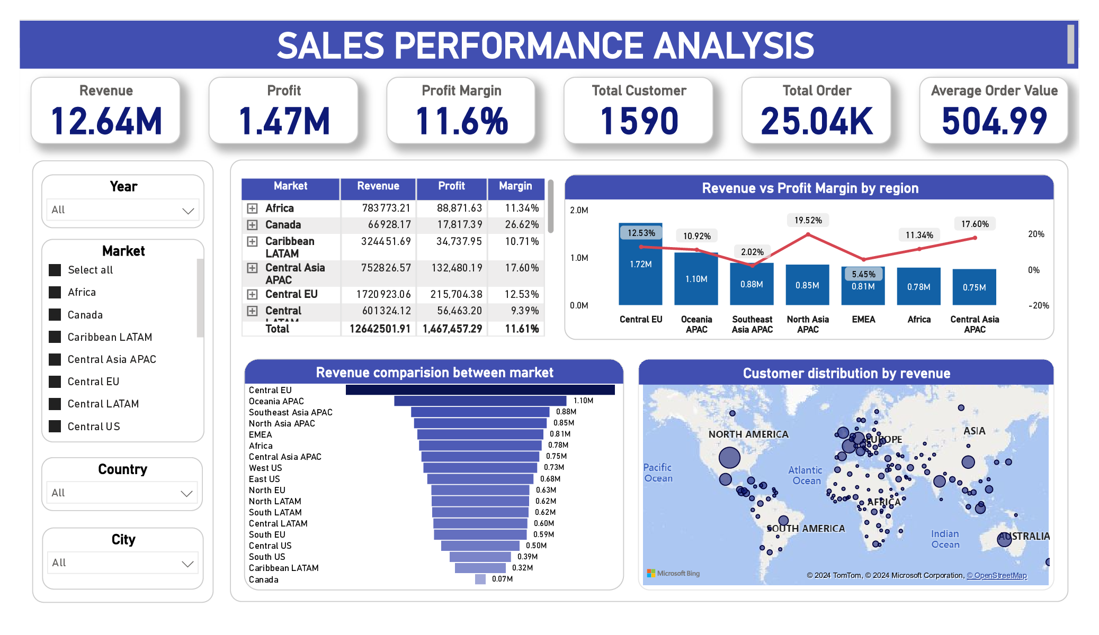
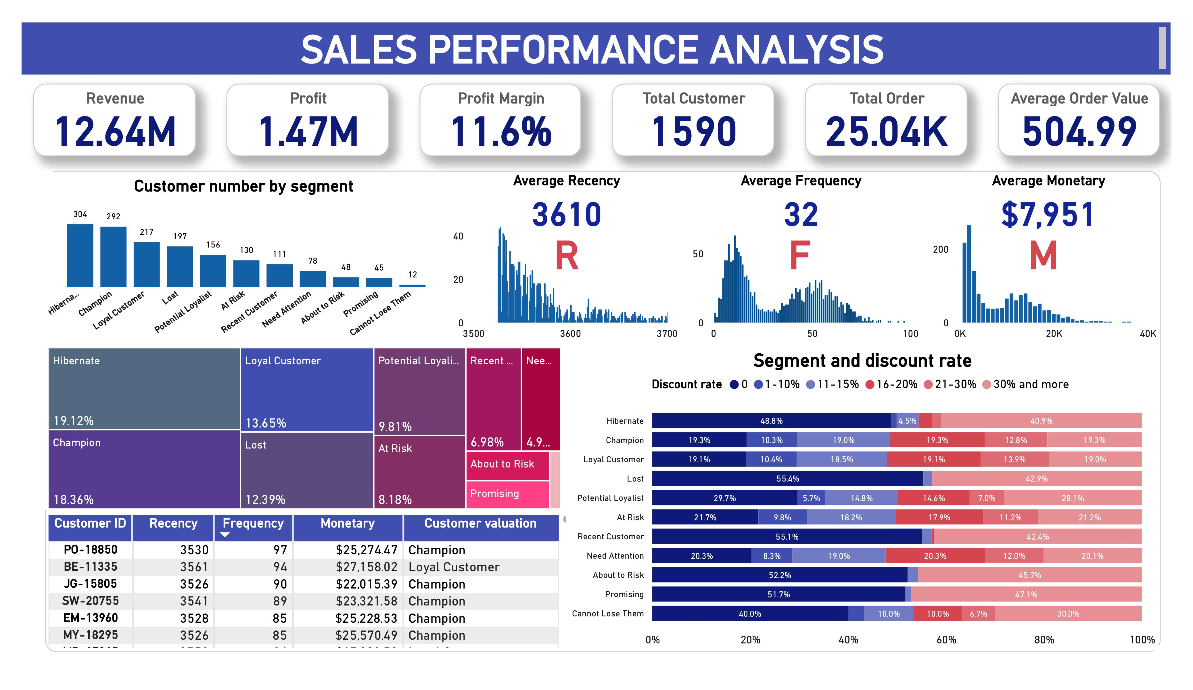
DASHBOARD VISUALIZATION
1. OVERVIEW
2. PRODUCT
3. CUSTOMERS
4. LOCATION
5. SHIPPING

Slide 12
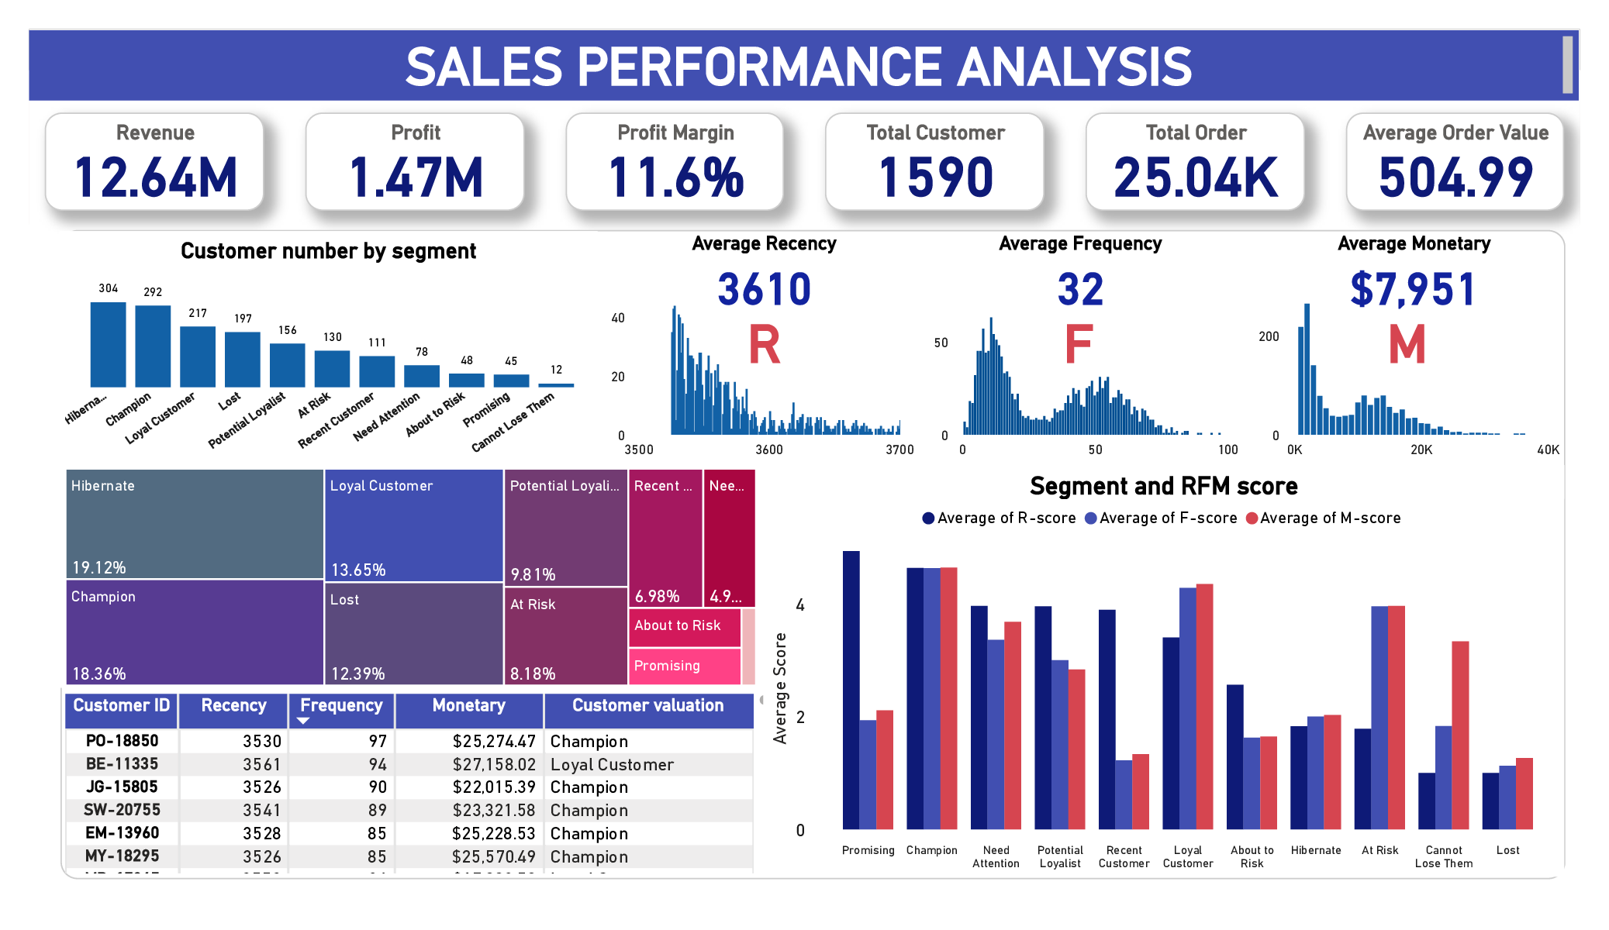
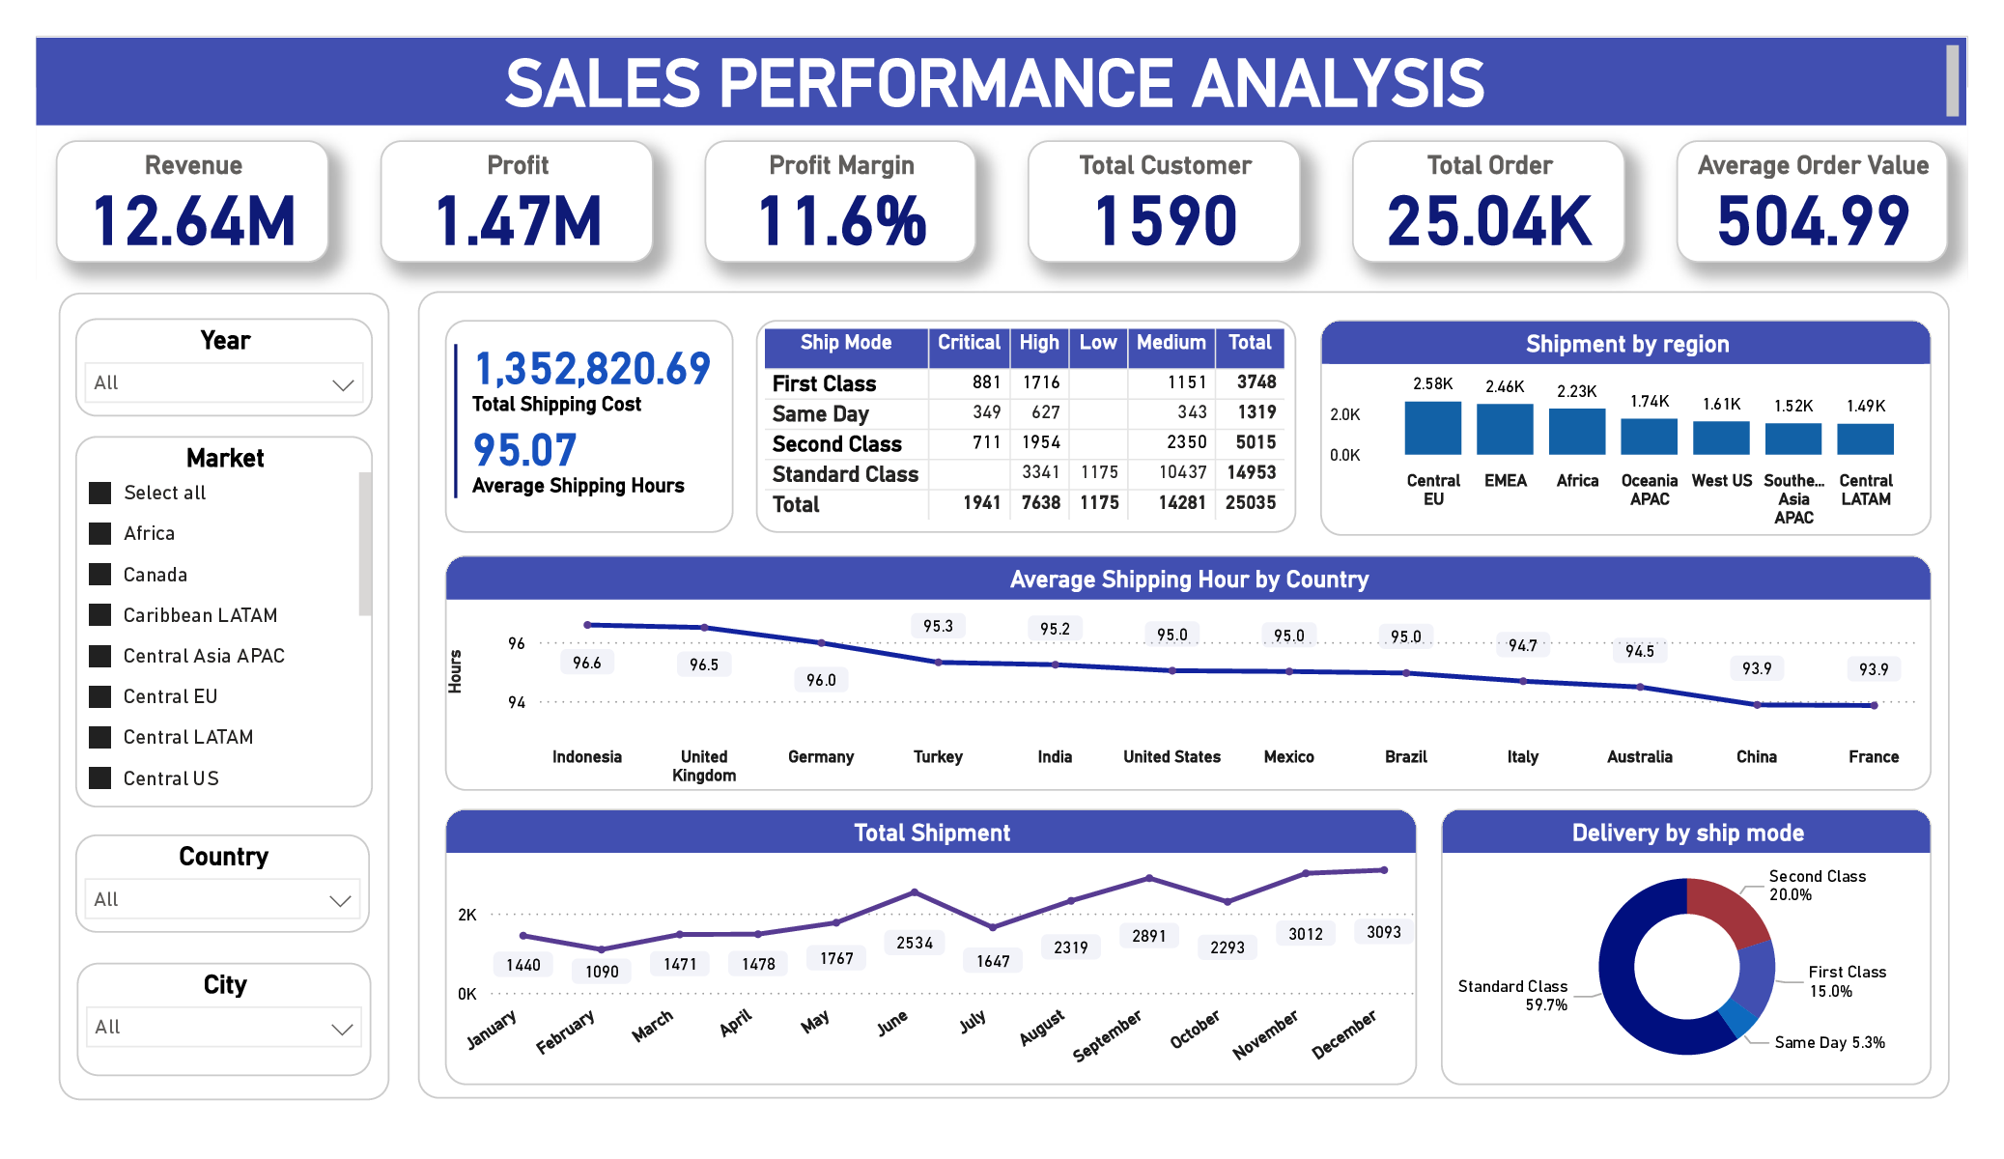
1. OVERVIEW
2. PRODUCT
3. CUSTOMERS
4. LOCATION
5. SHIPPING

Slide 13
DASHBOARD VISUALIZATION
1. OVERVIEW
2. PRODUCT
3. CUSTOMERS
4. LOCATION
5. SHIPPING

Slide 14
DASHBOARD VISUALIZATION
1. OVERVIEW
2. PRODUCT
3. CUSTOMERS
4. LOCATION
5. SHIPPING

Slide 15
DASHBOARD VISUALIZATION
1. OVERVIEW
2. PRODUCT
3. CUSTOMERS
4. LOCATION
5. SHIPPING

Slide 16
DASHBOARD VISUALIZATION
1. OVERVIEW
2. PRODUCT
3. CUSTOMERS
4. LOCATION
5. SHIPPING

Slide 17
03
PROBLEMS IDENTIFICATION

Slide 18
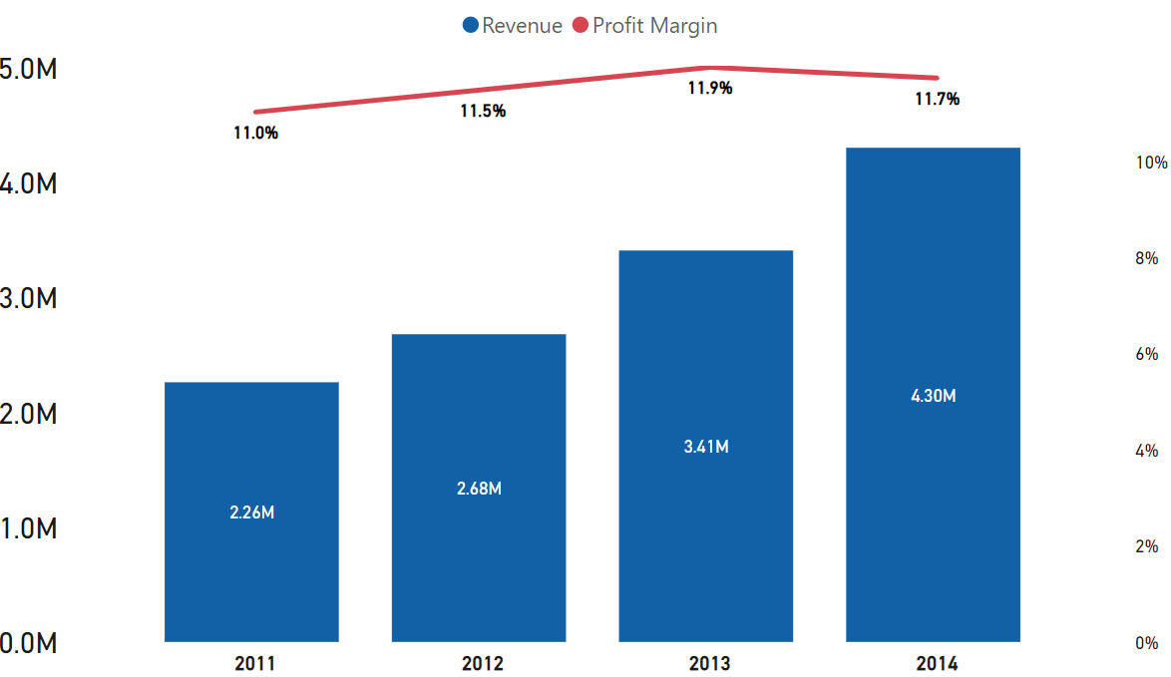
Revenue and Profit Increase Year Over Year
However, the company’s
profit margin slightly declined in 2014

Slide 19
So what caused the profit margin to decline?

Slide 20
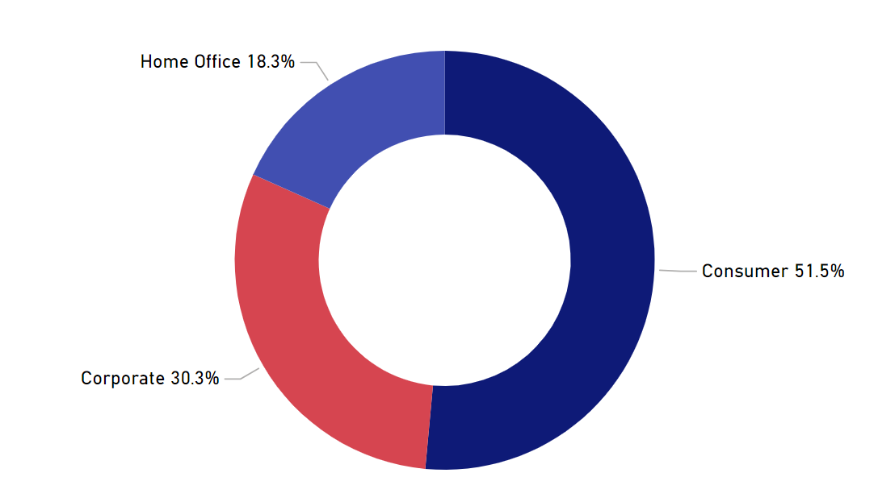
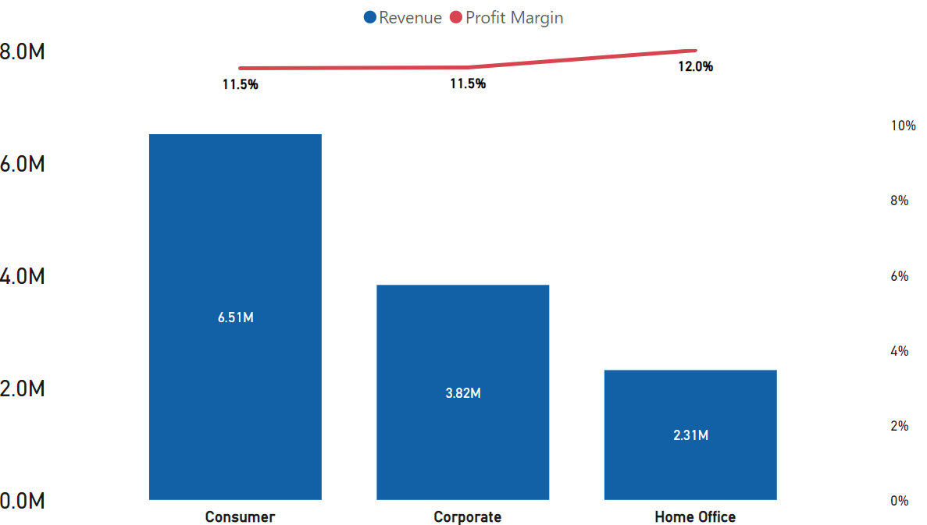
CUSTOMER SEGMENT
More than 50% of the revenue comes from the 'Consumer' segment
Profit margin remains consistent across all segments
CUSTOMER SEGMENT DOESN’T DIRECTLY AFFECT PROFIT

Slide 21
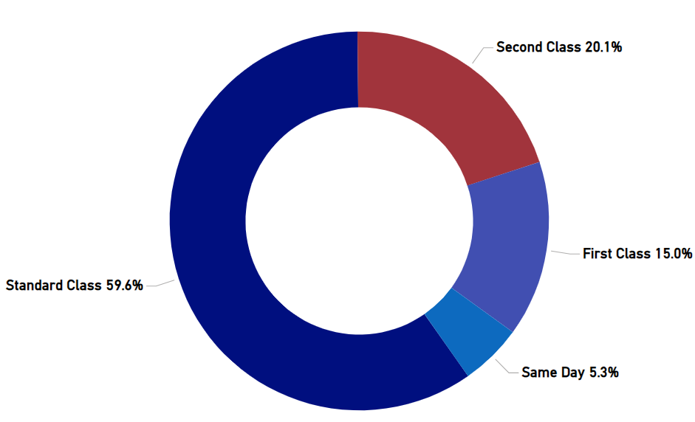
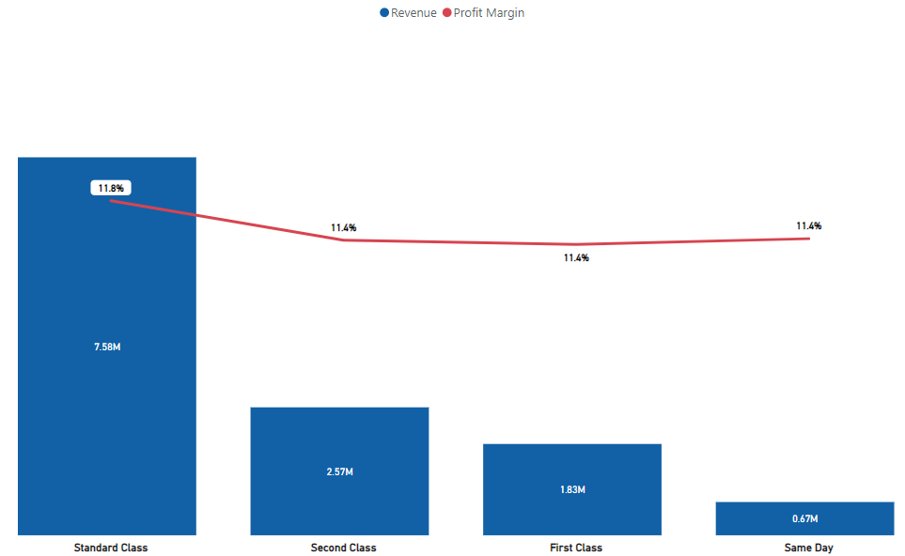
SIMILARLY, SHIP MODE DOES NOT IMPACT PROFIT
More than 50% of the orders used Standard Class
However, since shipping costs are not included in the overall cost, they do not directly impact the profit
SHIP MODE DOES NOT DIRECTLY AFFECT PROFIT

Slide 22
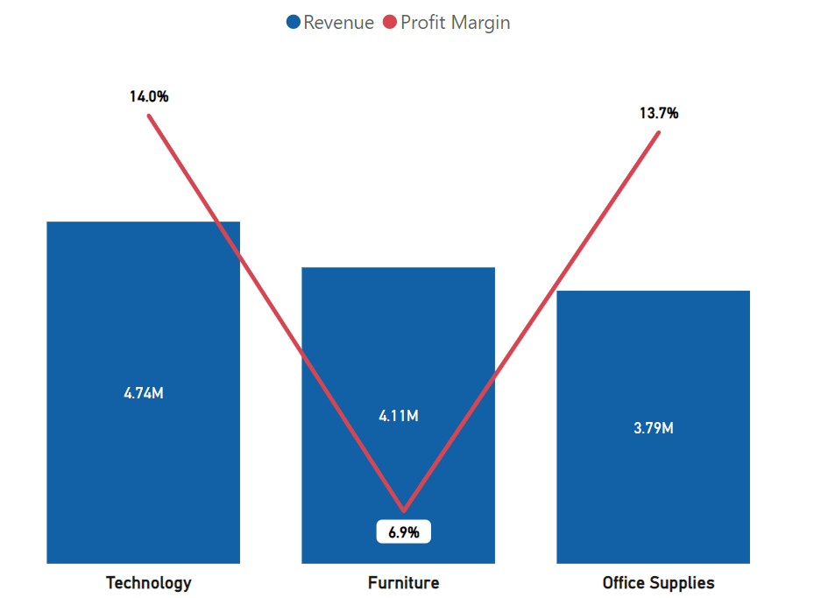
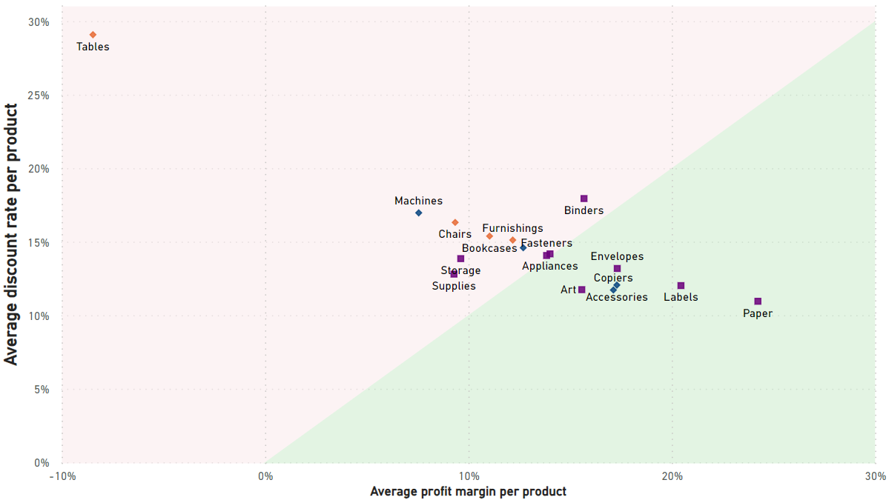
Some product sub-categories have very low or negative profit
The profit from the “furniture” is significantly lower compared to others
The discount is very high compared to the profit margins, especially those in the furniture category
DISCOUNTS IMPACT THE PROFIT OF MANY SUB-CATEGORIES

Slide 23
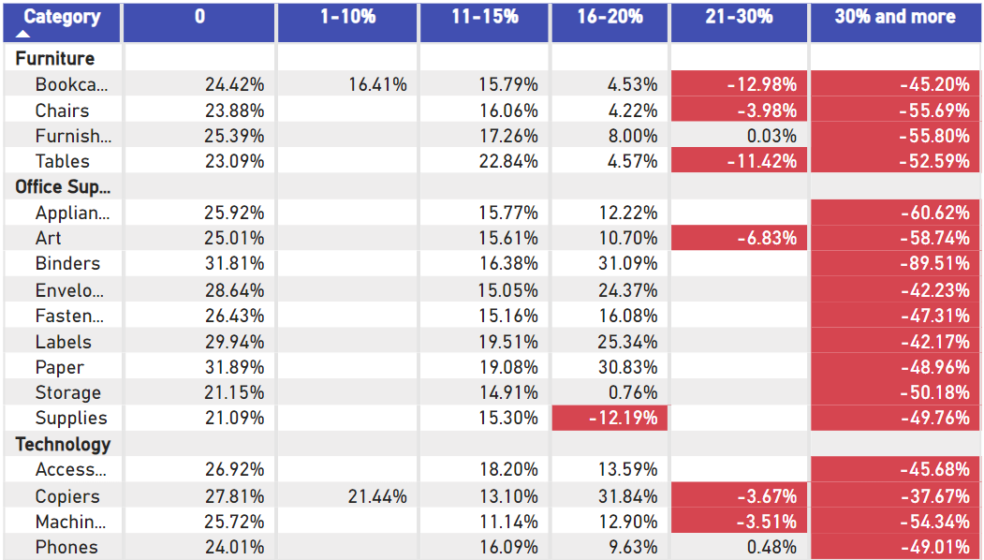
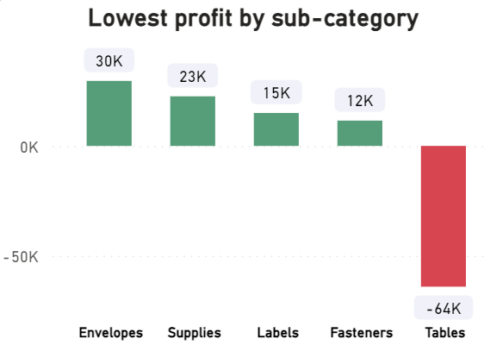
Especially, “Discount rate > 20%” generated negative profit margin
The discount rate more than 20% generate negative profit margin
The 'Tables’ sub-category showed the lowest and negative profit
DISCOUNTS IMPACT THE PROFIT OF MANY SUB-CATEGORIES

Slide 24
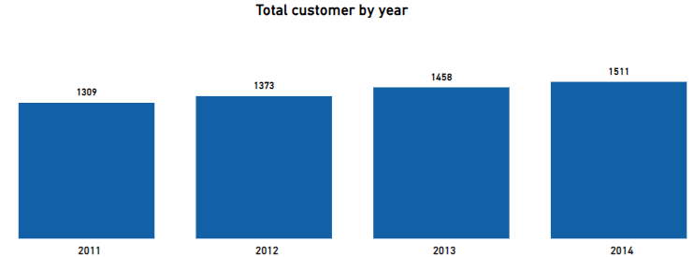
Moreover, the increase of new customers is not high
Therefore, the company also needs to find solutions to increase new customers

Slide 25
04
RECOMMENDATIONS

Slide 26
STOP DISCOUNT > 20% for ALL PRODUCTS
Discounting at a rate more than 20% led to low or negative profit margins, in spite of boosting sales.
Therefore, we should stop offering rate of discounts more than 20% on all products.
Team A
Team B

Slide 27
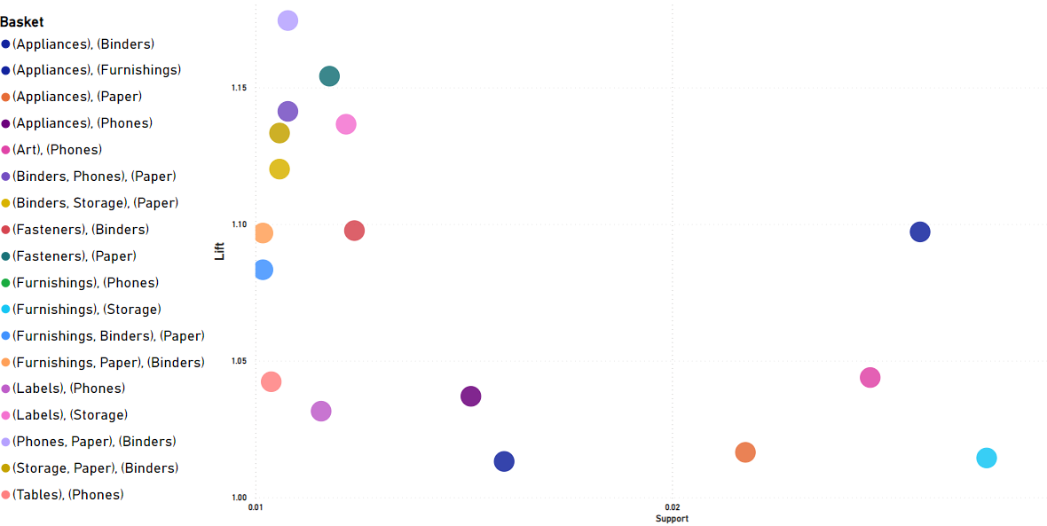
Discount products by basket analysis
Using Apriori to find product that are frequently purchase toghether. The results showed 18 basket group as illustrated

Slide 28
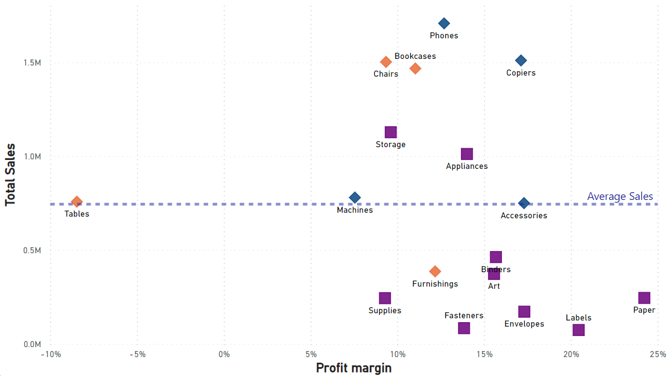
Discount products by basket analysis
To optimize the additional profit margin of cross-selling, among the 18 baskets listed, we need to implement the following:
(A) 1 sub-category that sells a lot, but has a low profit margin
(B) 1 sub-category that sells less, but has a higher profit margin
→ we can increase the overall profit margin of the order.
We have 4 suitable basket :
Phones + Art
Phones + Labels
Storage + Label
Furnishing + Storage

Slide 29
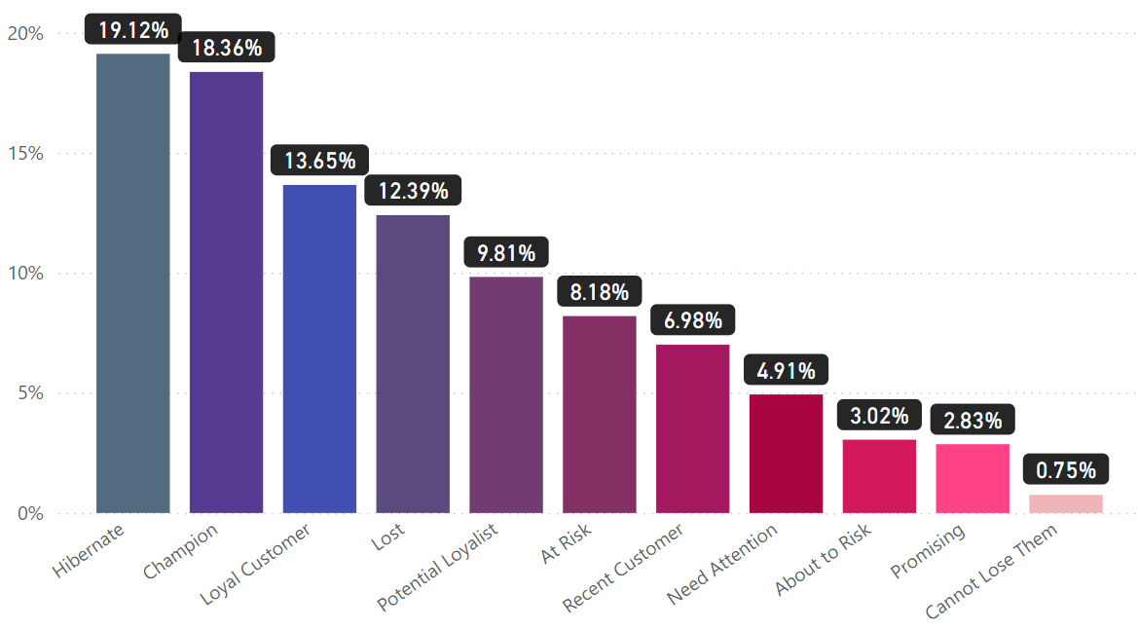
Discount products by Customer RFM
Focusing on Hibernate and Loyal Customer to boost Sales because they purchase more and easy to attract

Slide 30
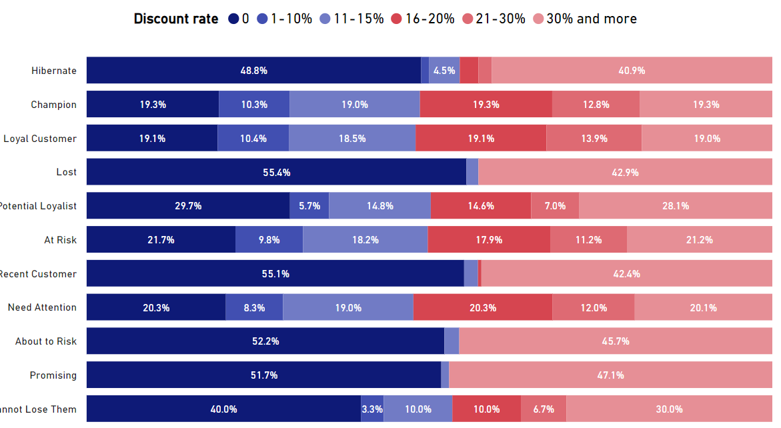
Discount products by Customer RFM
Discount more for “About to risk” to attract and retain them
Less discount for loyal customer because they may not need as steep of discounts compared to new or less engaged customers

Slide 31
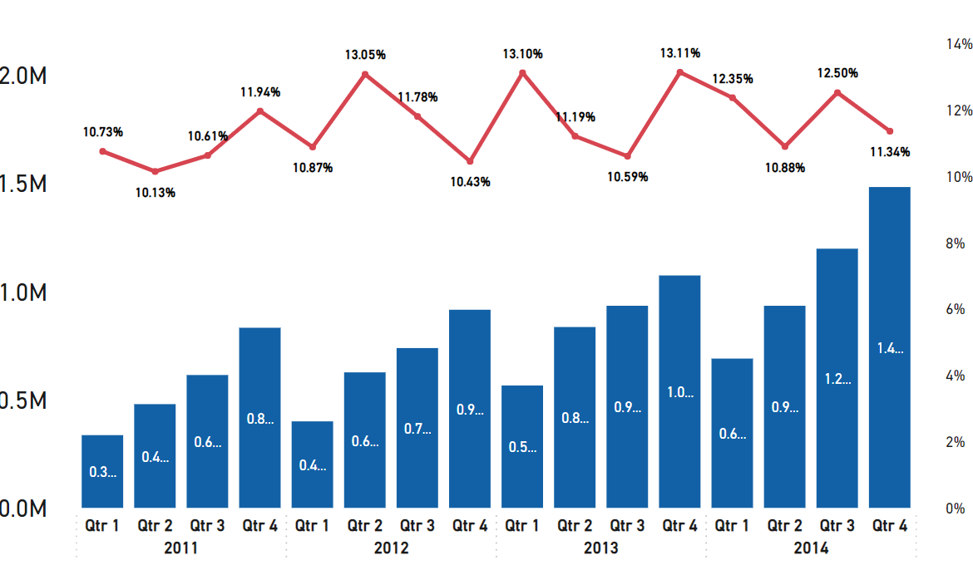
DISCOUNT BY SEASON
The revenue achieved the highest level at the final quarter of the year because the demand for big holiday such as Christmas, New Year,…
Discount more in the last season of the year

Slide 32
05
EXECUTIVE SUMMARY

Slide 33
EXECUTIVE SUMMARY
PROBLEMS IDENTIFICATION
REASONS
RECOMMENDATIONS
01
NEGATIVE PROFIT MARGIN
01
DISCOUNT RATE
01
Stop discount >20%
02
LOW RATE OF NEW CUSTOMERS
02
PURCHASE POLICY
02
Discount by basket
03
Discount by customer segment

